Slide 1
Project Title: Wave-Based Computation Using Dynamic Liquid Media and Quantum Simulation
Team Name: Quantum Minds
Mentor: Dr. S. Mohamed Nizar(AP)ECE
Institution: Rajalakshmi Institute Of Technology(RIT)
Team Members:
Akash S
Harish Ganapathy S
Ramya S

Slide 2
Work Completed (Week 3)
Finalized the hardware components for the prototype.
Selected Raspberry Pi 5 as the processing unit.
Selected VL53L5CX (8×8 LiDAR) for obstacle/depth sensing.
Selected MAX98357A I2S amplifier and 4Ω vibration resonance speaker for haptic feedback.
Prepared the hardware circuit diagram.
Studied Raspberry Pi software architecture and Linux environment.
Planned Qiskit integration with LiDAR data processing.

Slide 3
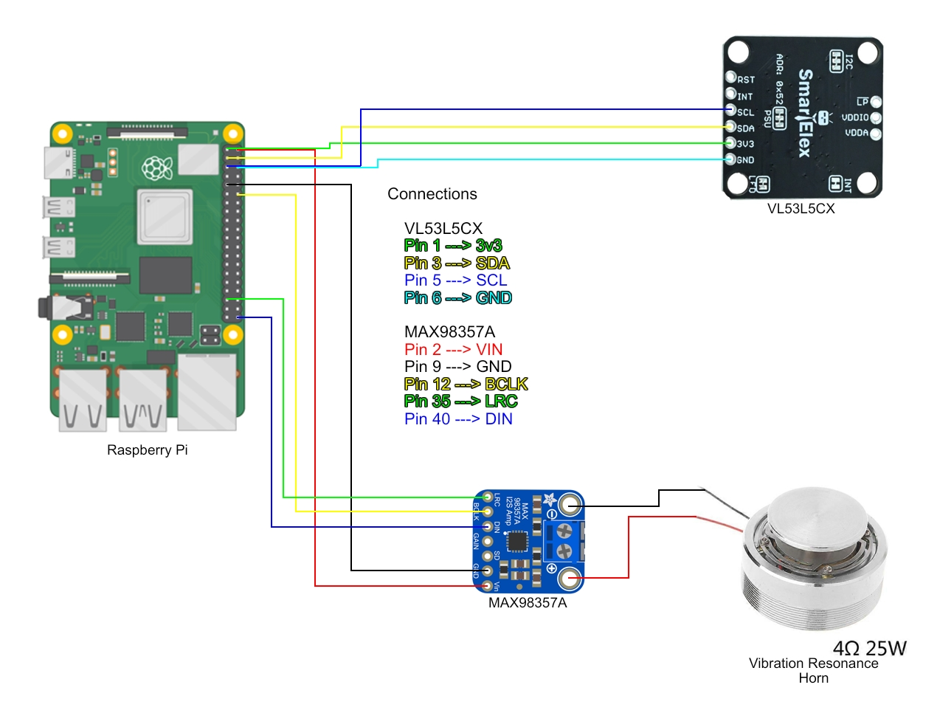
Hardware Architecture

Slide 4
Raspberry Pi Software Workflow
Raspberry Pi OS (Linux)
Python Programming
I²C communication with VL53L5CX
Read 8×8 distance matrix
Process obstacle information
Generate Quantum Random Number using Qiskit
Send vibration signal through I²S
LiDAR Sensor

Slide 5
Data Flow
LiDAR Sensor
↓
8×8 Distance Matrix
↓
Data Preprocessing
↓
Feature Extraction
↓
Qiskit Quantum Simulation
↓
Decision Logic
↓
MAX98357A
↓
Vibration Feedback

Slide 6
Who Did What?
Harish Ganapathy S
Finalized hardware components
Designed circuit diagram
Integrated hardware architecture
Ramya S
Studied Raspberry Pi interfacing
Verified sensor communication
Planned hardware testing
Akash S
Studied Raspberry Pi software workflow
Planned LiDAR data preprocessing
Researched Qiskit integration and data processing

Slide 7
Next Week Goals
Purchase all hardware components.
Assemble the prototype.
Interface VL53L5CX with Raspberry Pi.
Read real-time 8×8 depth data.
Interface MAX98357A and vibration speaker.
Run Qiskit simulation on Raspberry Pi.
Perform reliability and performance testing.

Slide 8
Expected Outcome
Functional Raspberry Pi prototype
Real-time LiDAR sensing
Accurate obstacle detection
Quantum-assisted processing using Qiskit
Vibration feedback for user navigation
Initial reliability and performance evaluation

Slide 9


